Slide 1
Climate change, agriculture & intellectual property rights

Slide 2
Climate change & agriculture
Extreme weather becoming more extreme
But a general rise in temperature
This will stress marginal farmers
i.e. Food security problem

Slide 3
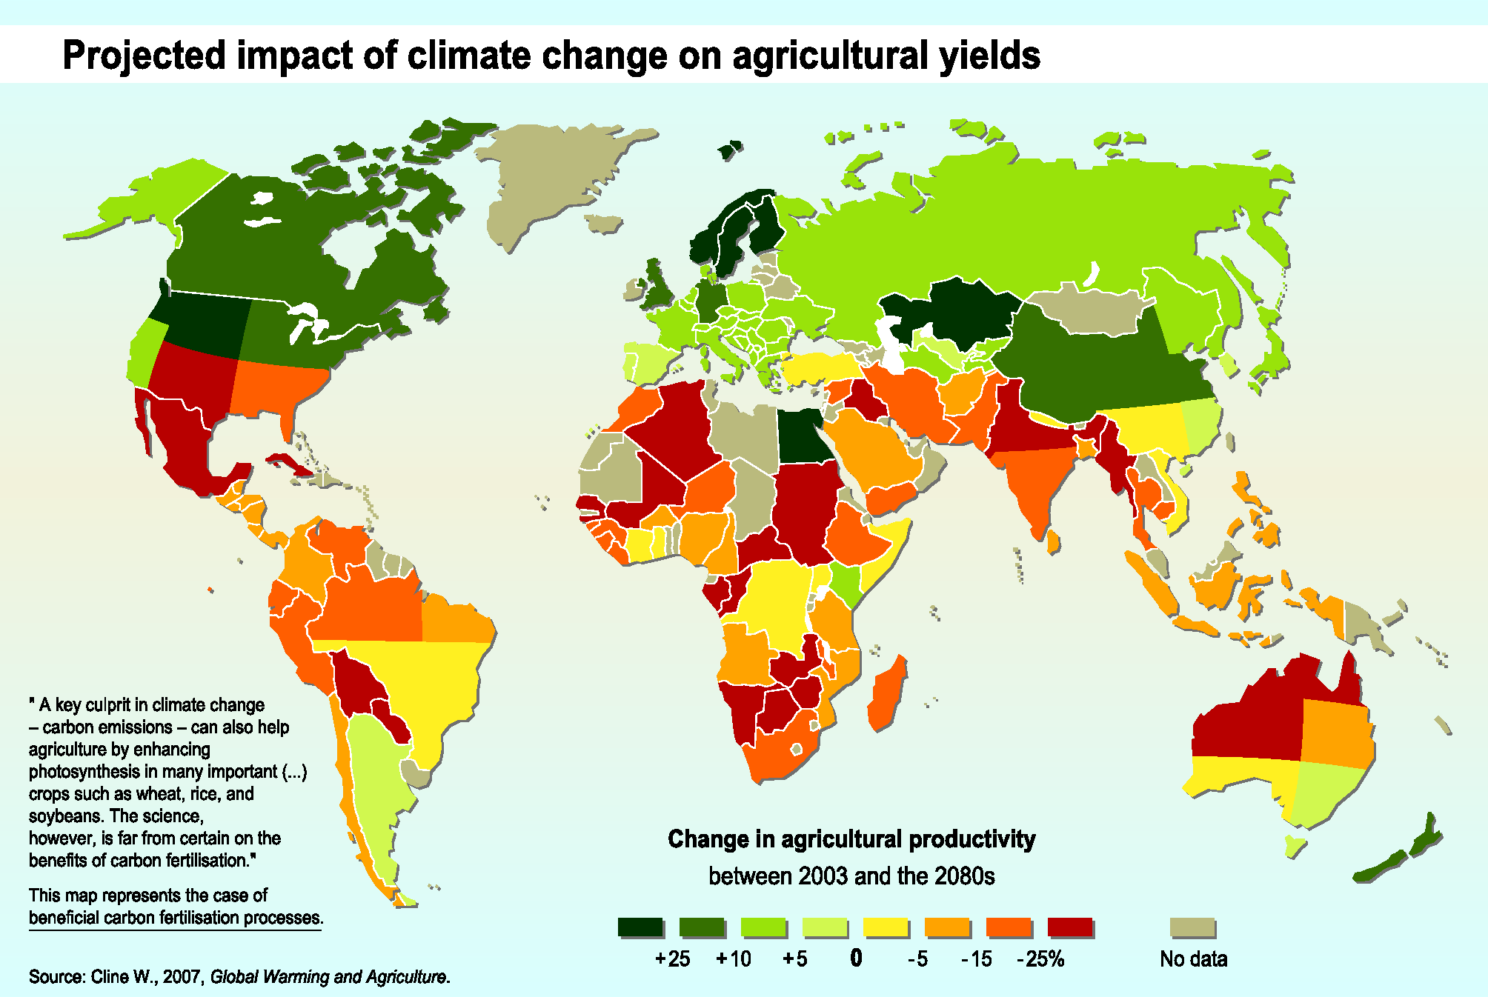

Slide 4
Economics of GMO crops
In poor countries between 80 and 90 percent of all farmers are subsistence farmers
The majority has less than 3 hectres
GMO seeds cost around US$600
But these (non reproducible) seeds require another US$1,400 of nitrate
Those marginal farmers live under $2 a day
They will not be able to afford to use them
If they could, they would have generated a better living for them US $5,600-1,400-600=$3,600

Slide 5
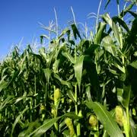

Slide 6
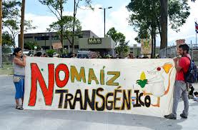

Slide 7
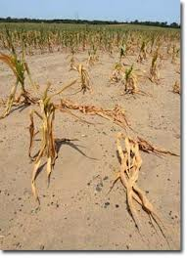

Slide 8
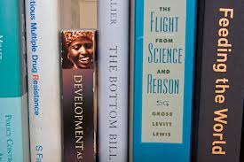

Slide 9
Technology transfer

Slide 10
IPRs and technology transfer
Debated in many forums:
UNFCCC
WIPO
WTO
Regarding mainly:
Clean energy technology
Other environmental technologies
Biotechnology = environmental technology

Slide 11
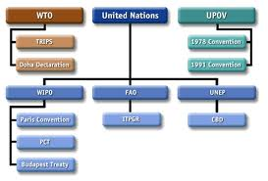

Slide 12
IPRs and biotechnology transfer
Also debated in many forums:
UPOV
WIPO
WTO
Convention on Biological Diversity
International Treaty on Plant Genetic Resources for Food and Agriculture
IPR issues more akin to pharmaceuticals than clean energy technology

Slide 13
Developing countries need GMOs
(+) impact of climate change on agriculture
(-) viability of traditional plant varieties
(+) need for GMO seeds
(+) % of population depends on agriculture
(+) depend on subsistence agriculture
(+) rely on seeds from traditional varieties
GMOs raise yields & adapt to climate change

Slide 14
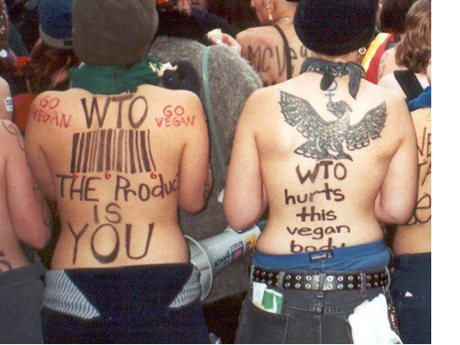

Slide 15
Developed countries have GMOs
GMO crops owned by Monsanto:
91% of soy
97% of maize
63% of cotton
59% of canola
DuPont, BASF, Monsanto, Syngenta, Bayer and Dow have patented 77 % of “climate ready crop genes”

Slide 16
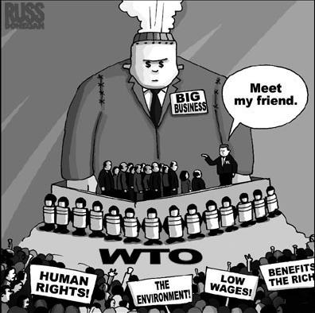

Slide 17
TRIPS Article 66.2 Technology transfer
Obliges developed to create incentives for tech transfer to least developed countries
Imprecise regarding:
specific outcomes
kinds of incentives
Hard to enforce vague obligation
No obligation regarding developing countries

Slide 18
TRIPS obligations and exceptions

Slide 19
TRIPS Article 27.1
Requires that patents be available for:
“any inventions”;
whether products or processes; and
in all fields of technology,
If they meet 3 requirements:
“new”;
“involve an inventive step”; and
“capable of industrial application”.

Slide 20
TRIPS 27.1
Requires WTO Members to:
make patents available and patent rights enjoyable
without discrimination as to:
the place of invention;
the field of technology; and
whether products are imported or locally produced.

Slide 21
TRIPS Article 27.2
Permits exclusion from patentability:
to prevent commercial exploitation
necessary to protect ordre public or morality,
including to protect human, animal or plant life or health or
to avoid serious prejudice to the environment.
GATT Art. XX jurisprudence relevant (Internet Gambling case Antigua vs US)

Slide 22
TRIPS Article 27.3(b)
Permits Members to exclude from patentability
plants and animals other than micro-organisms, and
essentially biological processes for the production of plants or animals other than non-biological and microbiological processes.

Slide 23
TRIPS Article 27.3(b)
Requires Members to provide for the protection of plant varieties either by:
patents or
an effective sui generis system or
any combination thereof.

Slide 24
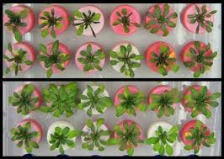

Slide 25
Article 27.3(b) – WTO Negotiations
How to judge the effectiveness of a sui generis system?
Interpret “effective” in light of TRIPS obligations regarding enforcement of IPRs?
Relationship between TRIPS, UPOV Convention and Convention on Biological Diversity.

Slide 26
Patents vs. Sui generis
Patents:
“new”;
“involve an inventive step”; and
“capable of industrial application”.
Cannot patent existing plant varieties because not “new”.
Sui generis: effective
Can protect existing plant varieties

Slide 27
Patents vs. Sui generis
Patents:
Not available for existing varieties, they are not “new”
UPOV:
Ditto
Sui generis:
Existing varieties CAN be protected under efficiency argument

Slide 28
Patents vs. Sui generis
India has a sui generis system
Medicinal use of turmeric registered
With this, India could attack US patents over medicinal use of turmeric
U of Mississippi patented turmeric for using healing wounds
U.S. Patent #5,401,504

Slide 29
Patents vs. Sui generis
Patents
can exclude from patentability under 27.2
27.2 covers plants and animals
Sui Generis
27.2 only applies to patents, but sui generis could incorporate equivalent
Members have debated exceptions that would be appropriate in a sui generis system:
experimental use
breeders' exemption

Slide 30
Monsanto Canada Inc. v. Schmeiser (Canada)
Cannot patent plants
Majority: Can patent genes and modified cells
Minority: Cannot patent genes and modified cells because part of plant

Slide 31
UPOV Convention

Slide 32
UPOV Convention
1961, 1972, 1978 and 1991
WTO Members disagree whether UPOV 1991 is best sui generis system
Some Members have their own sui generis systems with different lengths of protection

Slide 33
UPOV 1991
Breeder's right shall be granted where variety is:
new,
distinct,
uniform and
Stable.
Difficult to apply at molecular level in biotechnology

Slide 34
Should countries require novelty?
India: tumeric medicinal application
Not having a novelty requirement enables the government to protect plant varieties that nationals have long used for traditional purposes.
Prevents outside investors from patenting those plant varieties in their own countries by providing evidence of lack of novelty in the particular use of the plant.

Slide 35
UPOV 1991: compulsory exceptions to the breeder's right
(i) acts done privately and for non-commercial purposes,
(ii) acts done for experimental purposes, and
(iii) acts done for the purpose of breeding other varieties (the breeder’s exemption)

Slide 36
UPOV breeder’s exemption
Affected by technological advances.
New "reverse breeding" techniques shorten the time needed to create new varieties.
Shortens original breeder’s de facto period of exclusivity.
Proposals to phase in the breeder’s exemption according to the time it takes to reverse breed new varieties:
Similar to increasing patent term for pharmaceuticals
Appear designed to extend monopolies that would limit access.

Slide 37
UPOV farmers' exemption
UPOV 1978 allows farmers to save, exchange and sell some seeds.
UPOV 1991 lets government decide whether to permit farmers to save seeds for use on their own holdings, subject to "reasonable restrictions" and the protection of the "legitimate interests" of the breeder.
UPOV 1991 exception only applies to material harvested on the same holdings and not propagated material.
UPOV 1991 does not benefit farmers in the case of GMO varieties with terminator technology.
UPOV 1991 would have a negative impact on food security and create dependence on foreign commercial breeders for seeds.

Slide 38
Compulsory licensing
May restrict breeder's right only for reasons of public interest.
Compulsory license under TRIPS Art. 31 should qualify.
Ensure that the breeder receives “equitable remuneration”:
When authorizing a third party to perform any act for which the breeder's authorization is required (UPOV 1991),
When made in order to ensure the widespread distribution of the variety (UPOV 1978)

Slide 39
Equitable remuneration
Monsanto Canada Inc. v. Schmeiser
Monsanto chose an account of profits, rather than damages.
Majority compared Schmeiser’s profit attributable to the invention and Schmeiser’s profit had they used ordinary canola.
No difference in profits
Monsanto entitled to no money on their claim.

Slide 40
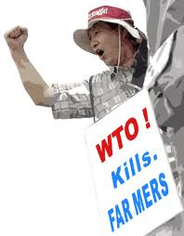

Slide 41
TRIPS, UPOV & biotechnology
Better balance of rights of producers and users of biotechnology in TRIPS than UPOV 1991.
UPOV 1991 favors plant breeders more than farmers.
UPOV 1991 more restrictive than TRIPS Articles 27.2 and 31.
But sui generis more flexible than TRIPS.

Slide 42
Convention on Biological Diversity

Slide 43
Convention on Biological Diversity
CBD focus on sovereign rights over genetic resources & informed consent.
Difficult to apply in practice.
Regulatory competition between:
developed countries' patent-based systems &
developing countries' sovereign-based systems.
Both may restrict access and innovation.

Slide 44
Conclusion

Slide 45
Change & obsolescence
Convergence of climate change, technological change, and economic change make current debates regarding IPRs and access to technology obsolete.
IPRs hamper innovation.
Technological change hampers IPRs.
One-size-fits-all approach to IPRs for biotechnology is inappropriate.

Slide 46
Keep Article 27.3(b) flexible!
TRIPS Article 27.3(b) flexibility:
Expands policy options in face of uncertain impact of climate change on food security and environment.
Facilitates avoiding conflicts between TRIPS, UPOV and CBD.
Facilitates evolutionary interpretation to take into account changing environmental conditions and changing technologies.

Slide 47
